Slide 1
ANALYSIS ON ALL FLUX BARRIER MODELS

Slide 2
RELATION BETWEEN SALIENCY RATIO AND POWER FACTOR
In SynRM the value of the inductances on the two axes play a major role and are very important due to the fact that torque is directly related to the difference between them and while maximum power factor Is dependent on their ratio .
Pf = ((Ld/Lq)-1)/((Ld/Lq)+1)
Torque = m*p*Id*Iq*(Ld-Lq)
Where m is the number of phases , p is no of poles and id and iq are d axis current and q axis current.
From the above equations we can observe that the torque is dependent on (Ld-Lq) ratio and power factor is dependent on (Ld/Lq)(Saliency ratio).

Slide 3
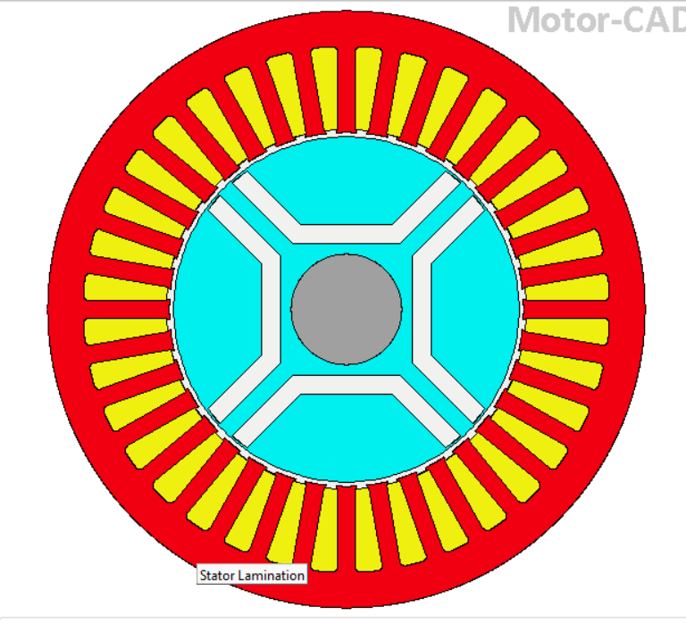
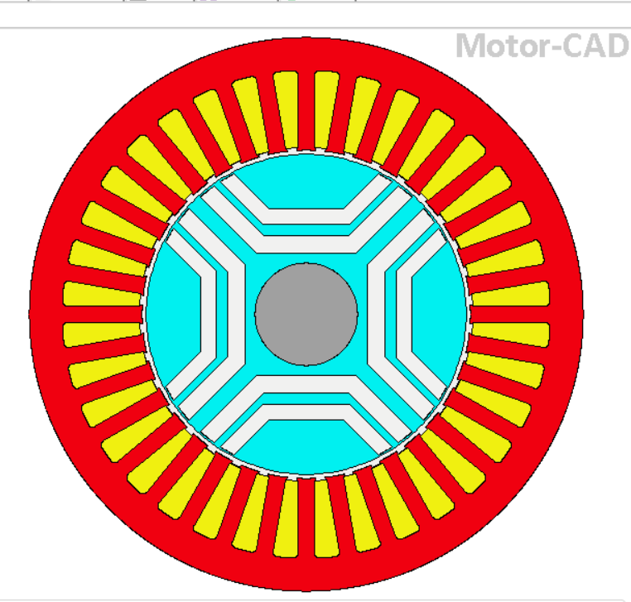
SYNRM WITH 1 FLUX BARRIER
SYNRM WITH 2 FLUX BARRIERS

Slide 4
WHY NOT 1 OR 2 FLUX BARRIER MODELS ?
Results obtained for for rotor with 1 and 2 flux barriers
PARAMETER | 1 FLUX BARRIER MODEL | 2 FLUX BARRIER MODEL
D axis inductance (mH) | 300.2 | 302.2
Q axis inductance (mH) | 128 | 90.55
Ld-LQ | 172.2 | 211.65
Saliency ratio | 2.34 | 3.3
As we can that the saliency ratio can be improved by moving to higher flux barrier .
So by increasing the number of flux barriers we can improve the saliency ratio thereby power factor.
Also maximum torque can be obtained when (Ld-Lq) ratio is large so by moving to higher flux barrier model better torque can be obtained.

Slide 5
RESULTS FOR 3 AND 4 FLUX BARRIER ROTOR
Results obtained for three and four flux barrier rotor at 65 degree current angle
Parameter | 3 Flux barrier model | 4 Flux barrier model
D axis inductance(mH) | 300.6 | 302.1
Q-axis inductance (mH) | 77.32 | 73.2
Ld-LQ(mH) | 223.8 | 230.9
Saliency ratio (Ld/Lq) | 3.88 | 4.11
By moving to 4 barriers the saliency ratio and (Ld-LQ)value is improved.

Slide 7
IMPROVEMENT IN SALIENCY RATIO
By moving to 3 and 4 flux barrier model the q axis inductance is found to be decreased.
By increasing the no of barriers the flux path in q axis is decreased and thereby saliency ratio is improved.
Also (Ld-Lq) ratio is also improved due to multiple barriers.

Slide 8
TORQUE
The torque equation of SynRM,
Torque = m*p*Id*Iq*(Ld-Lq)
The maximum torque can be obtained when (Ld-Lq) ratio is large.
From previous slides , we can say higher torque can be obtained for 4 flux barrier rotor compared to other rotor designs.

Slide 10
TORQUE RIPPLE
Torque ripple is an effect seen in many electric motor designs, referring to a periodic increase or decrease in output torque as the motor shaft rotates.
It is measured as the difference in maximum and minimum torque over one complete revolution, generally expressed as a percentage.
SynRM offers lower torque ripple and performance of machine is improved.

Slide 11
EFFECT OF TORQUE RIPPLE
Torque ripples have bad effects on the synchronous motors if they cause speed oscillations which contradict with the advantage of the synchronous motors being have constant speed applications.
Ripples have frequency coinciding with the natural mechanical frequency of the system, severe torsional oscillation will occur, and the shaft may be damaged.
Induction motors and synchronous motors may suffer from torsional oscillations due to these torque ripples.

Slide 12
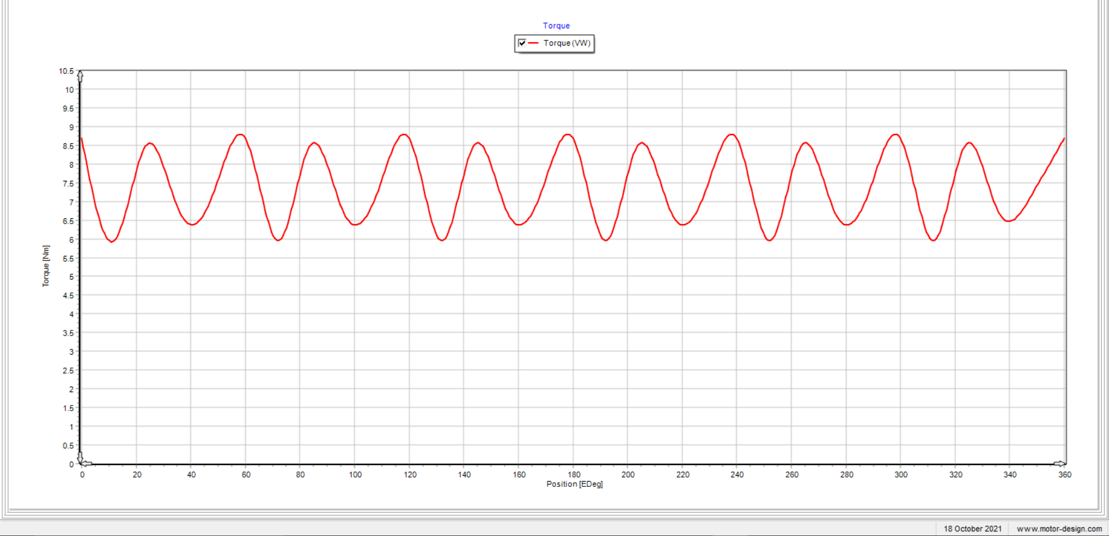
TORQUE CURVE FOR 4 FLUX BARRIER

Slide 13
TORQUE RIPPLE IN 4 BARRIER MODEL
Average torque = (max peak torque +min peak torque)/2
=(8.7+6)/2
=7.35Nm (from graph)
Average torque as shown in simulation output is 7.4052 Nm
Torque Ripple =(max peak torque –min peak torque )
=8.7-6
=2.7Nm
Torque ripple as shown in output is 2.6204 Nm

Slide 14
Theoretically calculated value :
% Torque ripple = (max peak torque – min peak torque)/average torque
= (8.7-6)/7.35
= 36.7
Software output:
%Torque ripple =(max peak torque – min peak torque)/average torque
=(2.6204)/7.4052
= 35.3

Slide 15
COMPARISON
The 4 flux barrier model provides around 6% less torque ripple compared to 3 flux barrier model so it is mostly preferred for stable performance.
ROTOR MODEL | % TORQUE RIPPLE
3 Flux barrier | 41
4 Flux barrier | 35.3

Slide 16
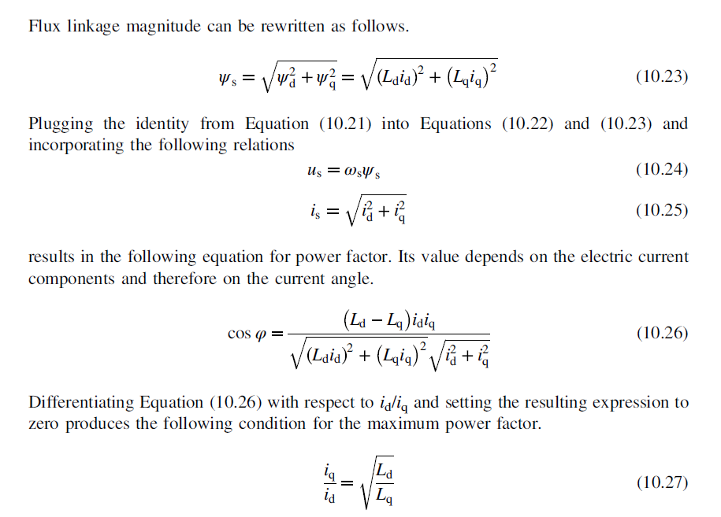
POWER FACTOR RELATION
The current angle is always in the range of [0,∏/2]

Slide 17
TO ACHIEVE MAXIMUM POWER FACTOR
The power factor reaches its maximum at this current angle
k=arctan(√(Ld/Lq))
where,
Ld= d axis inductance mH
Lq= Q axis inductance mH
k is current angle .
Ld/Lq is saliency ratio of the machine.
The maximum power factor is therefore ,
power factor =((Ld/Lq)-1)/((Ld/Lq)+1)

Slide 18
MAX PF IN 4 FLUX BARRIER MODEL
In our case to achieve maximum power factor we take the maximum saliency ratio value attainable.
Say for Ld/Lq=4.11
Current angle, k= arctan(√4.11)
=64°
For this current angle from the graph we can note that the power factor obtained is 0.68 which is the maximum power factor obtained.
Similarly if the current angle is known necessary saliency ratio to attain high pf can be obtained.
We can also note that at this current angle the torque ripple attained is also low.

Slide 19
RESULTS FOR 4 BARRIER MODEL

Slide 22
Contd..
The current angle was varied for every 5 deg and the power factor for SynRM is noted.
SynRM can obtain maximum power factor only for current angle between 0 and 90 degree.
The maximum power factor can be obtained for maximum saliency ratio. In our case in 4 flux barrier model the max saliency ratio obtained was 4.11 at 65 deg current angle.
So ,max power factor occured at this current angle .
Similary with max power factor we can find out the max angle at which high saliency ratio occurs.

Slide 24
SYNRM WITH 5 FLUX BARRIERS

Slide 25
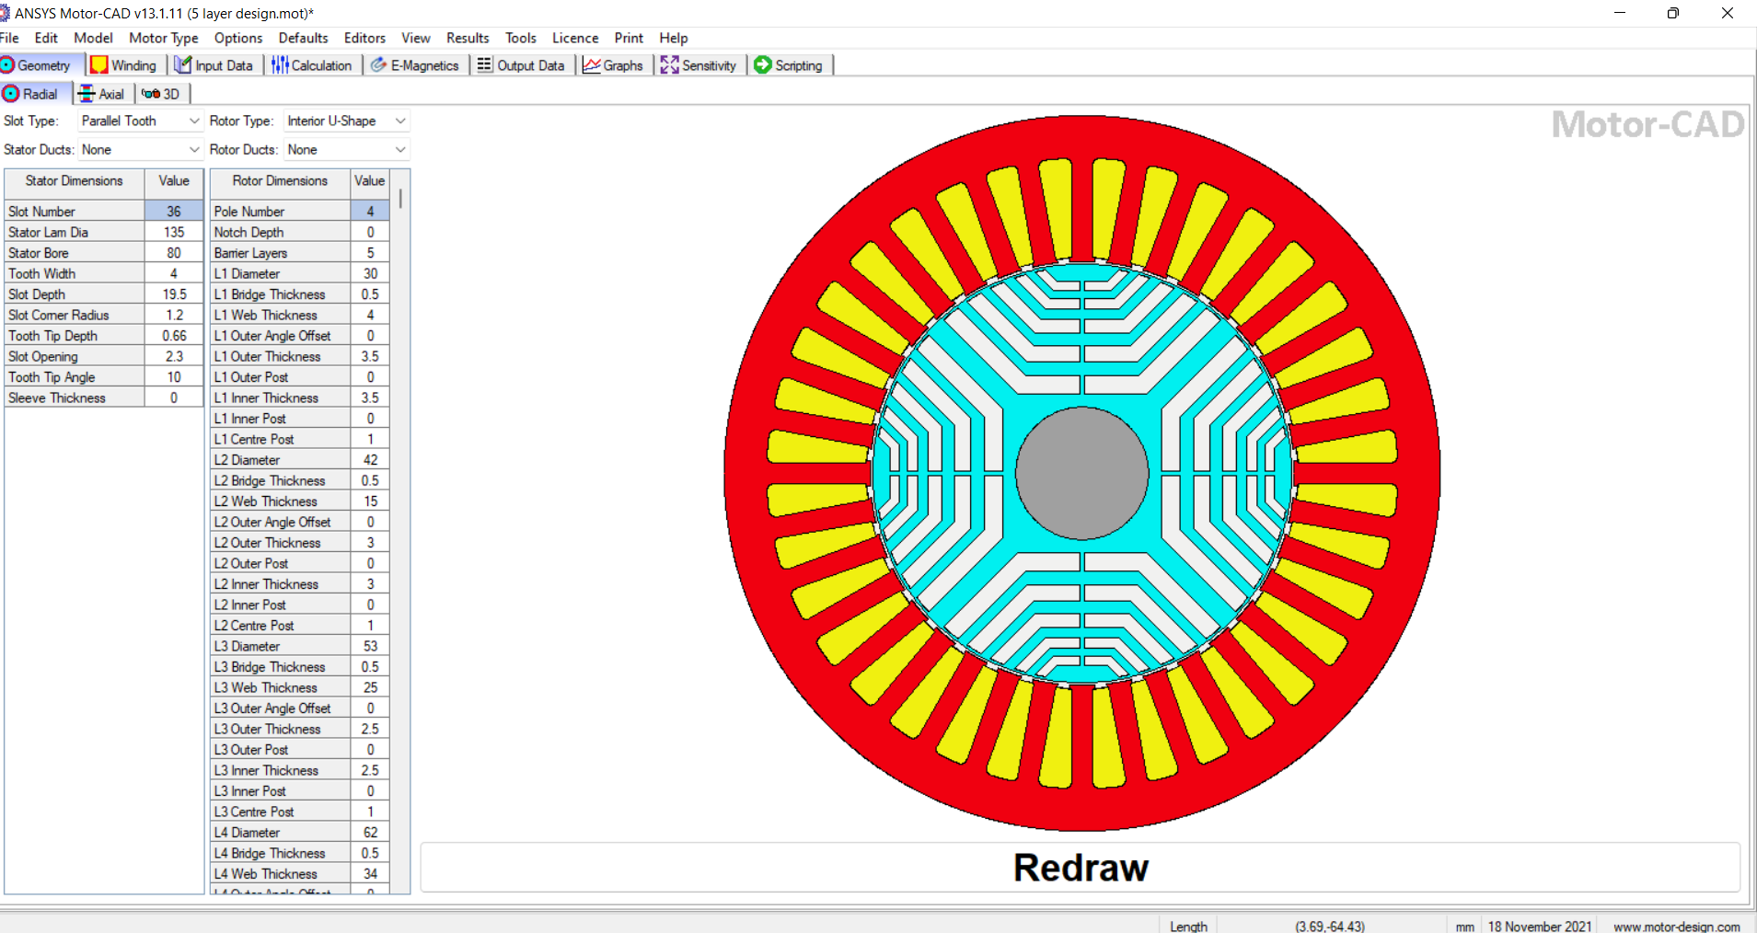

Slide 26
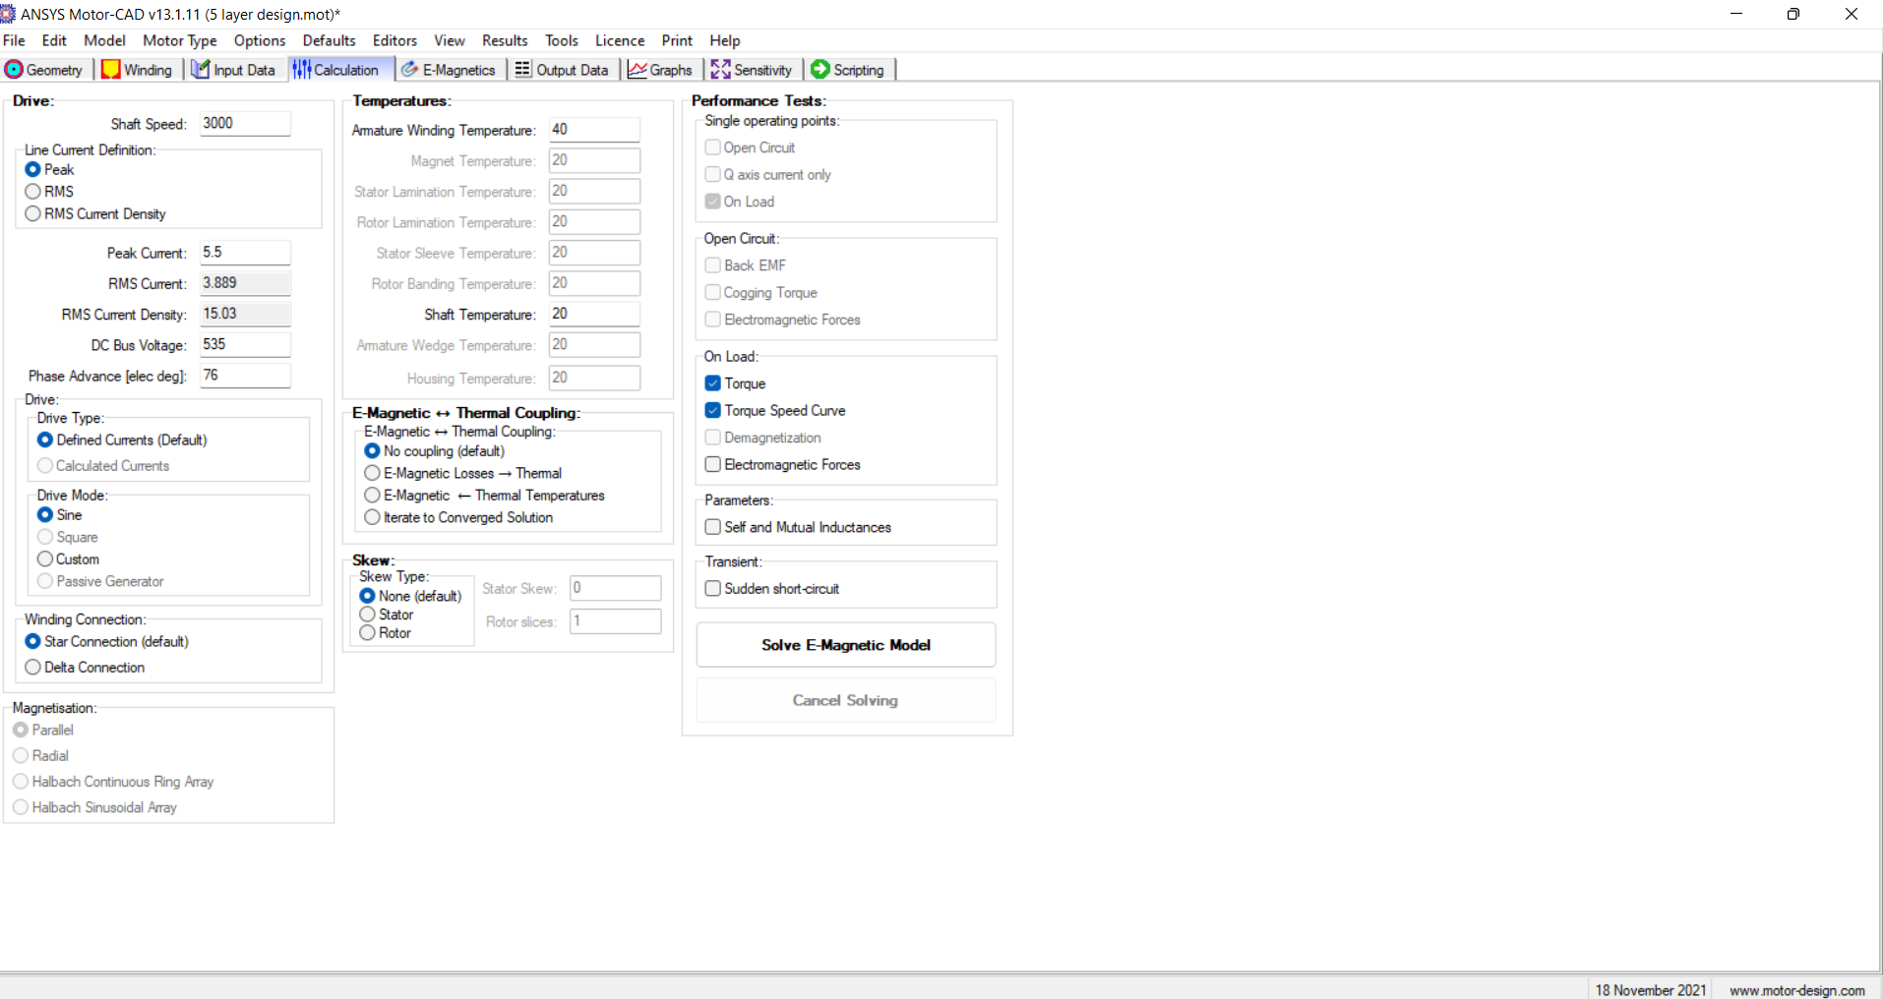
INPUT DATA

Slide 27
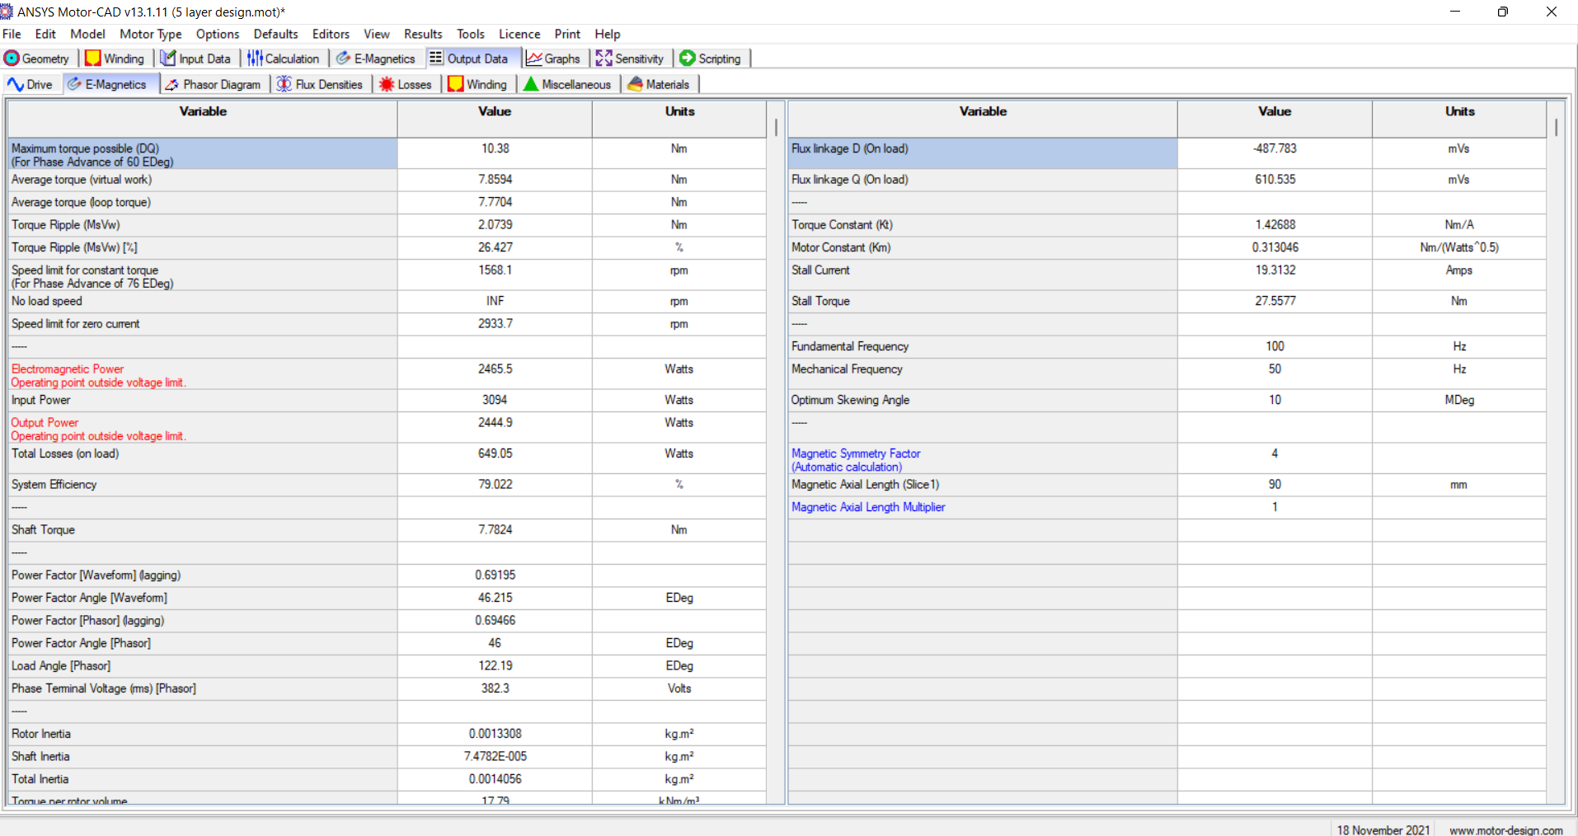
OUTPUT DATA

Slide 28
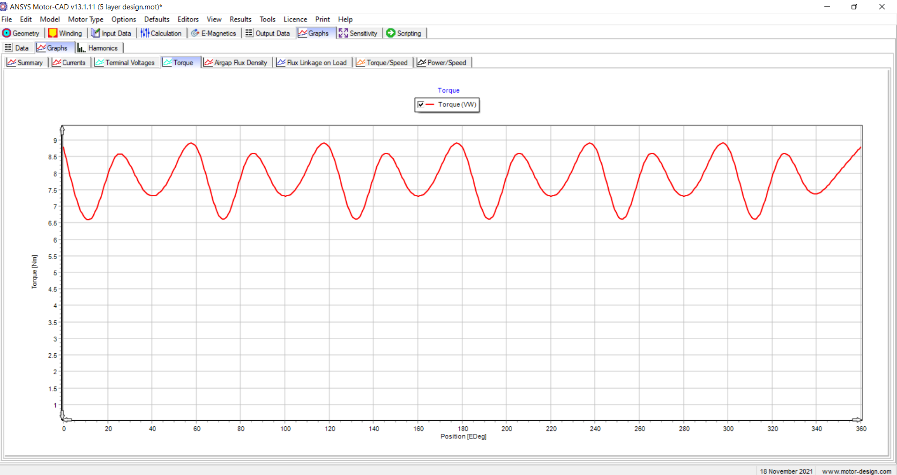
TORQUE

Slide 29
SALIENCY RATIO
Ld = 458.9
Lq = 91.4
Saliency Ratio = Ld/Lq
= 458.9/91.4
= 5.02

Slide 30
INFERENCE
By moving to 5 flux barriers and above the output obtained for power factor and torque ripple were nearly equal to 4 flux barrier model,
Moving to higher barrier model the outputs get saturated.
To have better control over power factor and torque ripple we can change the thickness of the flux barriers in 3 or 4 layer model to improve saliency therby power factor and low pf.

Slide 31
REDUCING THICKNESS OF FLUX BARRIER

Slide 32
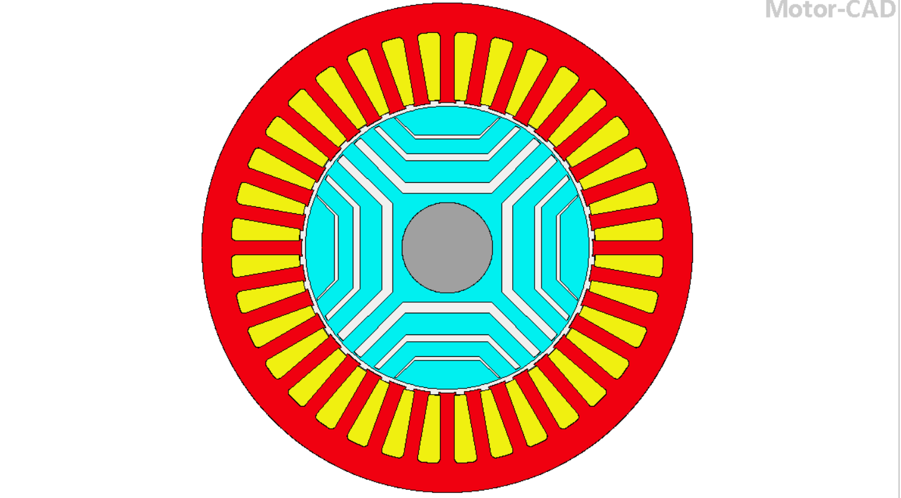
3 FLUX BARRIER WITH LOWER THICKNESS

Slide 33
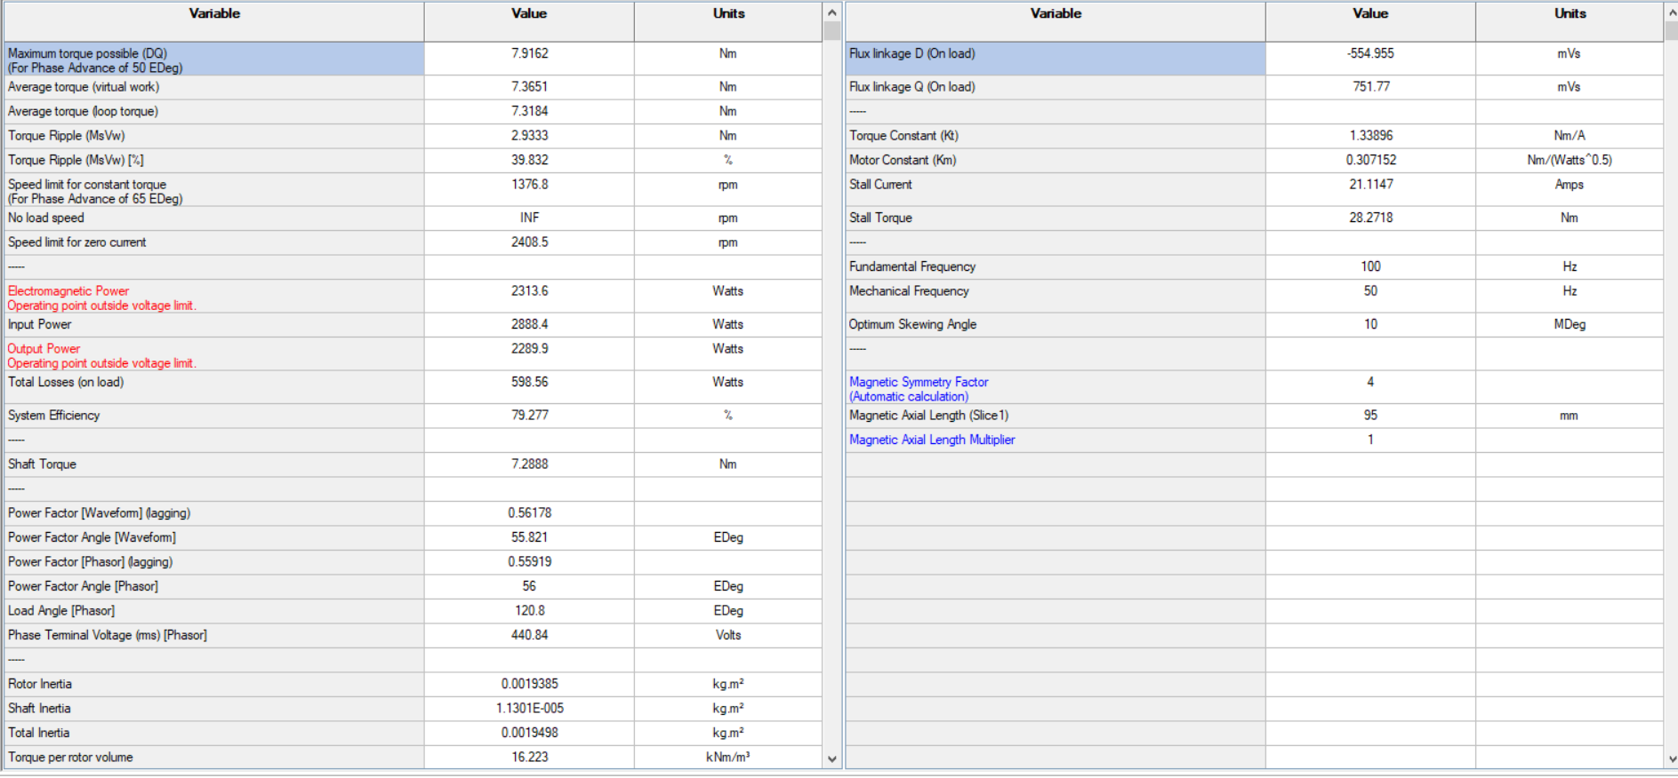
OUTPUT

Slide 34
OUTPUT DATA
Current angle = 65 degree
Torque = 7.36 Nm
Saliency ratio = 2.905
Torque Ripple = 39.832%
Power factor = 0.56

Slide 35
CURRENT ANGLE VS TORQUE RIPPLE

Slide 36
CURRENT ANGLE VS POWER FACTOR

Slide 37
INCREASING THICKNESS OF FLUX BARRIER

Slide 38
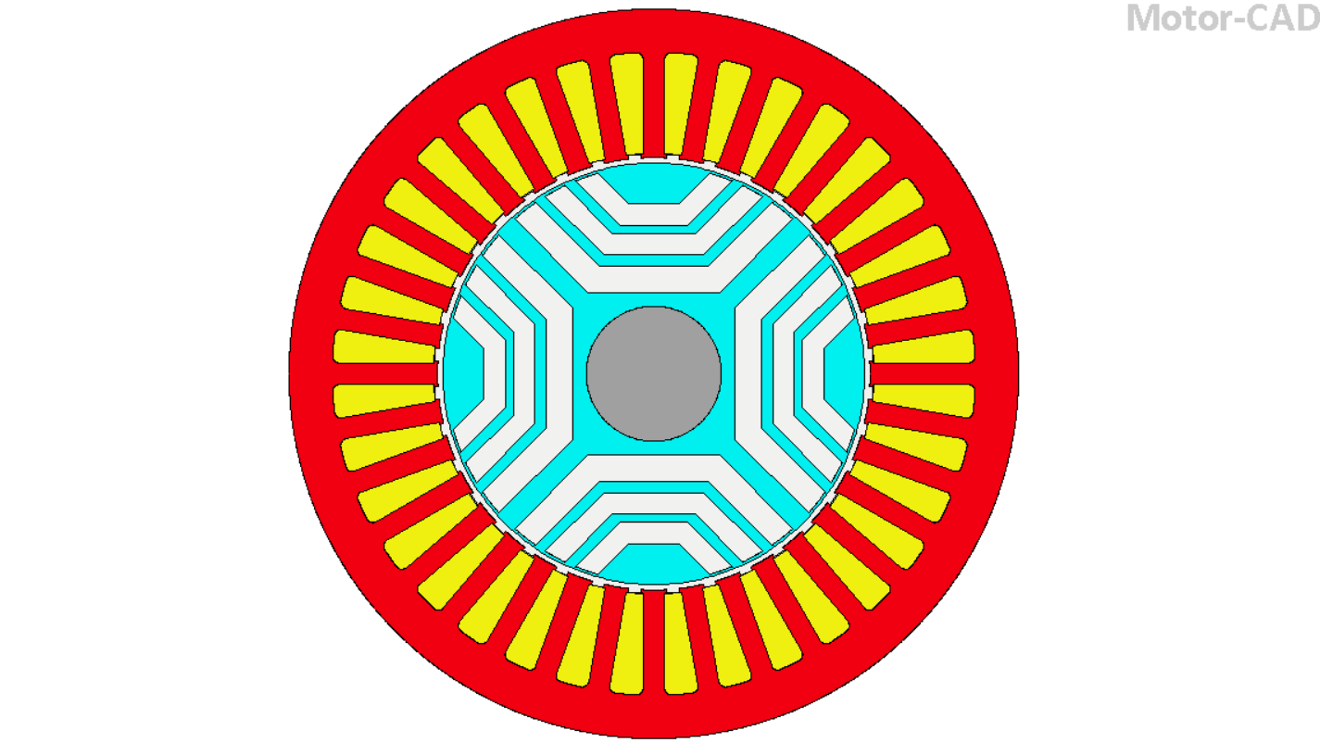
3 FLUX BARRIER WITH HIGHER THICKNESS

Slide 39
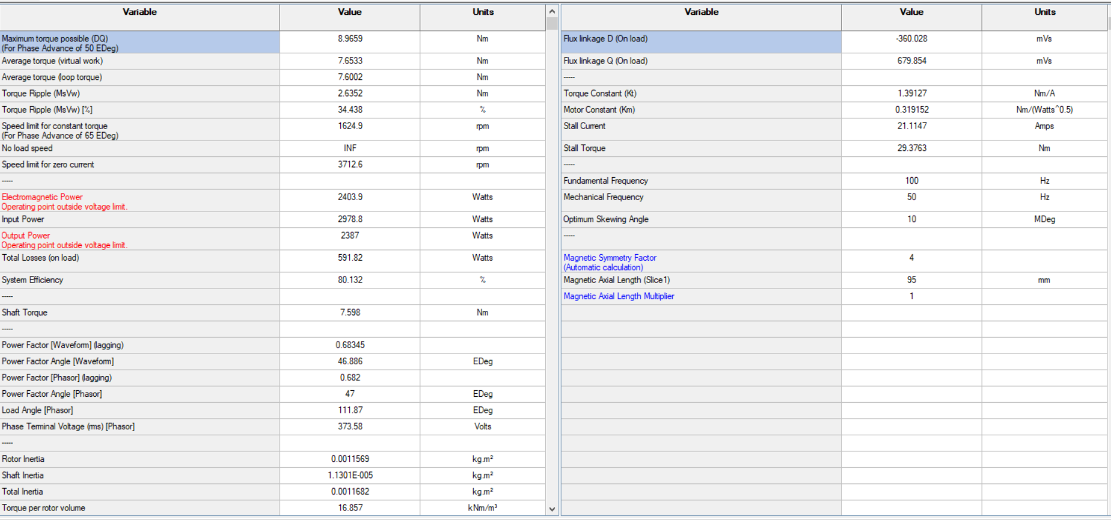
OUTPUT

Slide 40
OUTPUT DATA
Current angle = 65 degree
Torque = 7.65 Nm
Power Factor = 0.6834
Saliency Ratio = 4.04
Torque Ripple = 34.438%

Slide 43
INFERENCE
Reducing thickness of flux barrier results in increased flux flow along q axis compared to d axis as a result the saliency was found to be decreased and so power factor.
By increasing the thickness the saliency ratio was improved and so pf due to reducing in q axis flux therby torque ripple was also found to be decreased.

